Slide 1
Deep in AGI
Changyu.Zeng
2021.9.14

Slide 2
Contents
Previous
Ideas
AI-GA
Meta-Learning and DRL
Metaverse and POET
Conclusion

Slide 3
Previous
Introduction to AGI
Has same intelligent as human in various fields.
NARS
A project aimed at the building of a general purpose intelligent system
Reinforce Learning
Maximize the reward when interacting with environment and learn from experience

Slide 4
Ideas
AGI = Algorithm + Virtual Environment + Computation
Algorithm
Uncertainly to improve to be more efficient
Virtual Environment
Provide the training place of agents
Computation
Make amounts and complex calculation available

Slide 5
AI-GA
Definition
Artificial Intelligence Generation Algorithm (AI-GA) refers to a method in which AI learns to generate algorithms to evolve into AGI.
Three pillars[1]
Meta-Learning Architecture
Meta-Learning Algorithm
Effective Learning Environment

Slide 6
Meta-Learning
Definition
Defined as “learn to learn”. It is expected to have the ability to solve problem quickly under the limited known knowledge.
Principle
In meta-learning, the training units are hierarchical. The first-level training units are tasks. The second-level training units are the data corresponding to each task.

Slide 7
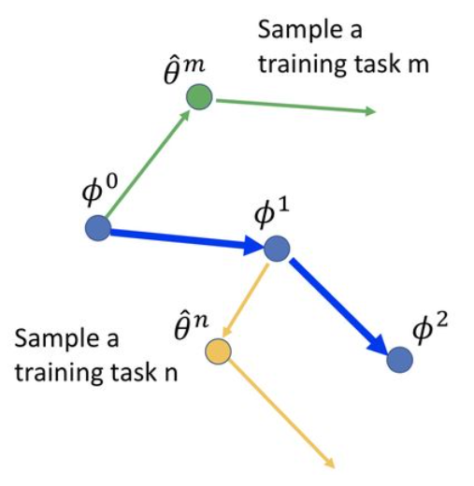
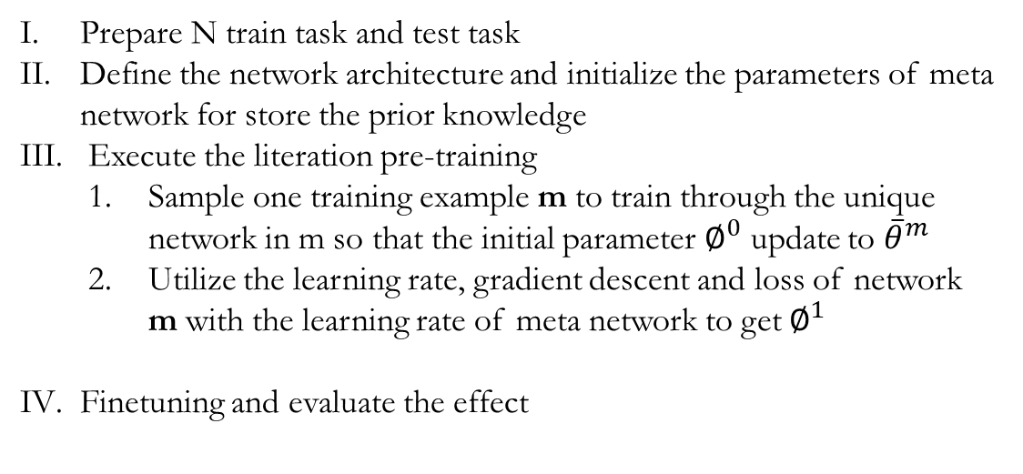
Algorithm Flow
Prepare N train task and test task
Define the network architecture and initialize the parameters of meta network for store the prior knowledge
Execute the literation pre-training
Sample one training example m to train through the unique network in m so that the initial parameter $∅^{0}$ update to ${\overline{θ}}^{m}$
Utilize the learning rate, gradient descent and loss of network m with the learning rate of meta network to get $∅^{1}$
Finetuning and evaluate the effect

Slide 8
Deep Reinforce Learning
Definition
DRL is an algorithm combined with reinforce learning and deep neural network. It allows agents to make decisions from unstructured input data without manual engineering of the state space.
Compare with Q-Learning
DRL applies deep neural network to substitutes the Q-table so that it can cope with large dimension raw image data.

Slide 9
Metaverse
Definition
the term is typically used to describe the concept of a future iteration of the internet, made up of persistent, shared, 3D virtual spaces linked into a perceived virtual universe.
Pros
Save the cost
Improve the security
Accelerate the training speed

Slide 10
POET
Definition
Paired Open-Ended Trailblazer (POET) generates a trivial environment paired with a randomly-initialized agent. It aims to achieve two goals[2]:
evolve the population of environments towards diversity and complexity
optimize agents to solve their paired environments

Slide 11
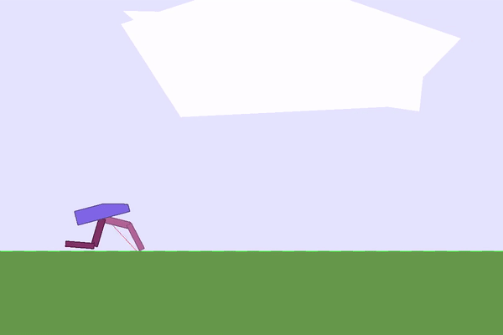
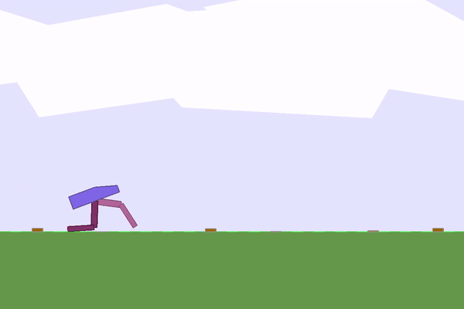
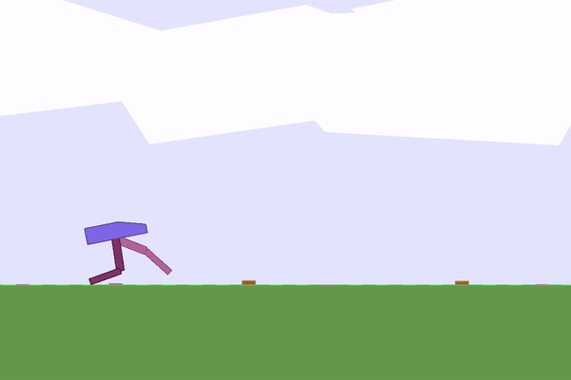
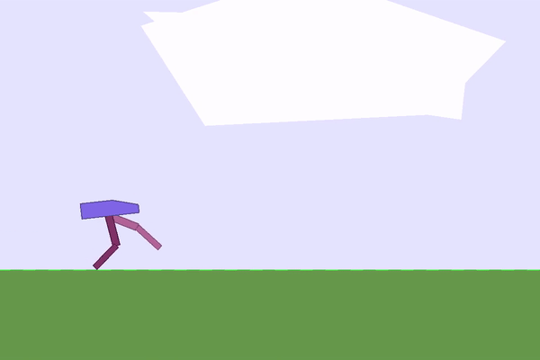
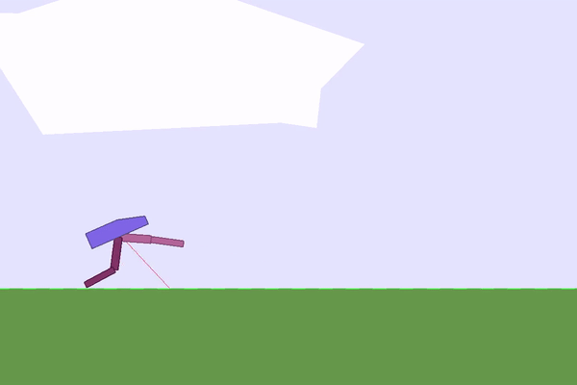
Example
Parent Environment,
Iteration 400 Score: 298
Child Environment,
Iteration 400 Score: 207
Parent Environment,
Iteration 1175 Score: 304
Parent Environment,
Iteration 2300 Score: 349
Parent Environment,
Iteration 1175 Score: 311

Slide 12
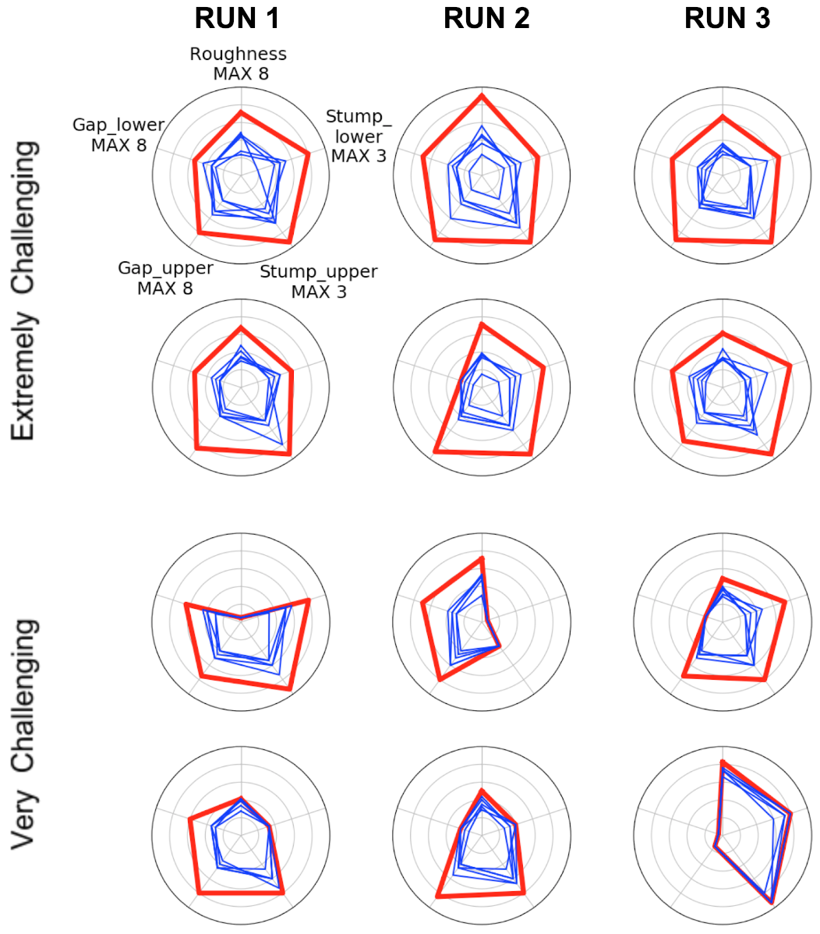
Results
Curriculum-based learning (in blue) fails to reproduce POET performance (in read) in a diverse set of challenging environments invented by POET. Notice that the blue pentagons, each of which is a run of the direct-path curriculum-based control, consistently fail to reach the level of the red target.

Slide 13
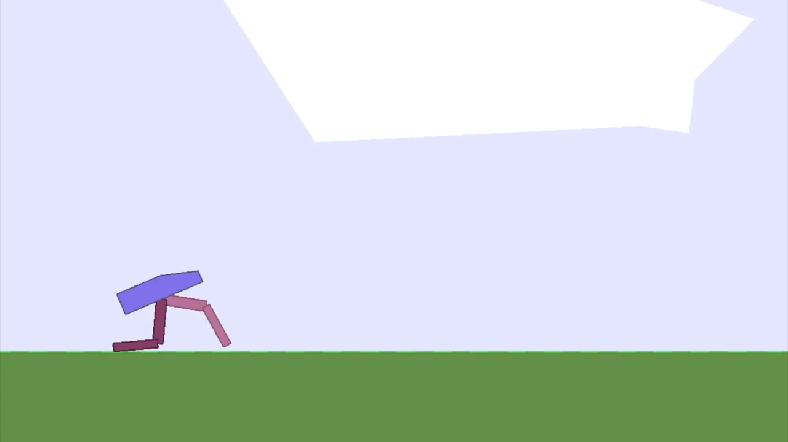

Slide 14
Conclusion
Algorithm
Based on meta-deep reinforce learning, increasing improve as efficient as possible
Environment
Develop by game engineer developer companies, may be the short board
Computation
Determined by GPU product company such as Nvidia.

Slide 15
References
[1]Jeff Clune. “AI-GAs: AI-generating algorithms, an alternateparadigm for producing general artificial intelligence”. In:arXivpreprint arXiv:1905.10985(2019).
[2]Rui Wang et al. “Paired open-ended trailblazer (poet): Endlesslygenerating increasingly complex and diverse learning environ-ments and their solutions”. In:arXiv preprint arXiv:1901.01753(2019).

